Slide 1
SAY NO TO SUGAR
Team Super-Ninja(TA342)
Members:
Lu, Lin, Ram & Toni.

Slide 2
Agenda
Project Solution
Dataset and Sources
User Stories
What Happens Next

Slide 3
Project Solution
WHAT:
A website advising sugar & calories intake and a recommendation plan to be more healthy
WHY:
obesity is one of the top 5 diseases in Australia and around the world.
one third of Australian are now obese or overweight.
FOR WHOM:
Parents and their obesity kids
The government
SO WHAT:
Getting information from the website
Tracking and making plan for daily diet
Communicate with other users online
Finding nearby places for exercise or entertainment

Slide 4
Research and Data Sources
Life expectancy of an obese adult is 2-4 years less than those adults with a healthy weight
childhood obesity can have lasting health and more like to be obese in their adult like.
One in 4 children (ages 2-7) were overweight in 2014-2015
At the age 18-21, 15% of those born from 1994-1997 were obese compared with 8% of those born from 1974-177
World Health Organisation dropped its sugar intake recommendations from 10 to 5 %.
Cost of obesity in Australia health system in 2008 was estimated to A$48 billion
Source: refer to reference list

Slide 5
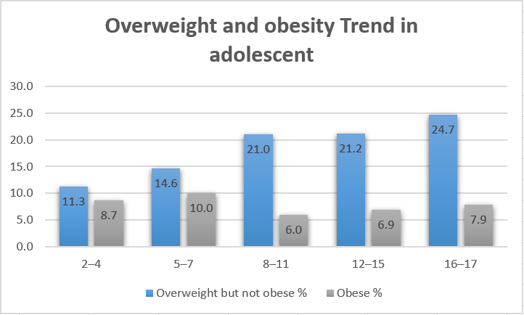
Age trend vs overweight or obesity in 2015
source: Australia Institute of welfare and health

Slide 6
User Stories
Iteration 1
Iteration 2
Iteration 3
As a mother of 2 obesity children, I would like to view some information about the harm of sugar, sugar level in food, substitute food, healthy diet suggestion as well as the BMI of my children so that I can know what the disadvantage of over intake and what should I provide for my children to eat.
Will be finished before 31/08/2018
As a girl of 6 years old, I want to know how I will be by input what I am eating everyday so that I know whether I should keep fit or not.
Will be finished before 14/09/2018
As a father of not enough cooking experience, I want to looking for healthy diet of other family and the effect so that I can ask them to give me some suggestion on cooking healthy food.
Will be finished before 05/10/2018

Slide 7
Conclusion
What we have done?
Determine the topic (sugar)
Finding the dataset
Building up google cloud server for website
What we will do next?
Finish user interface design
Finish iteration 1
Testing

Slide 8
References
Obesity: Prevalence Trends in Australia, Retrieved(2018)
https://sydney.edu.au/medicine/research/units/boden/ANPHA%20Obesity%20Prevalence%20Trends.pdf
A picture of overweight and obesity in Australia, Retrieved(2018)
https://www.aihw.gov.au/reports/overweight-obesity/a-picture-of-overweight-and-obesity-in-australia/contents/table-of-contents
Sugar intake for adults and children, Retrieved (2018)
http://www.who.int/nutrition/publications/guidelines/sugars_intake/en/

Slide 9
Thank You!
QUESTIONS?

